Slide 1
INF10025
Data Management and Analytics
Week 01 – Part 3
Filter & Query

Slide 2
Filters and Queries
Datasheet Filter | Design Grid | Running | Saving | Reusing

Slide 3
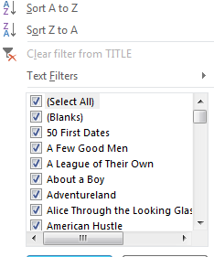
Datasheet Filters
Filters are a useful way of specifying which records are to be retrieved by Access
Click the  icon on any of the Field headings
Simply check one or
more of the boxes on the left side
of the menu to choose a record
Click Select All toggle to
select / unselect all records

Slide 4
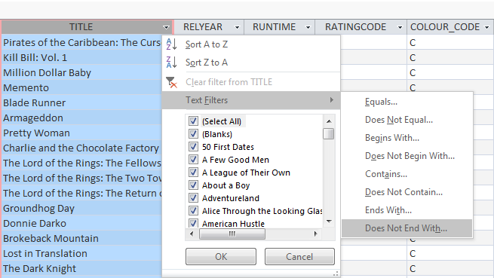
Datasheet Filters (cont.)
Click the Text Filters menu option to specify others filter options

Slide 5
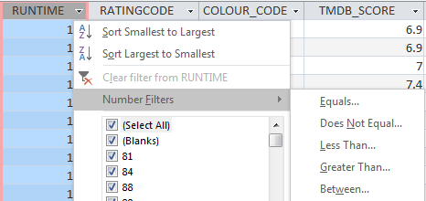
Datasheet Filters (cont.)
Numeric columns have a different selection of filter options

Slide 6
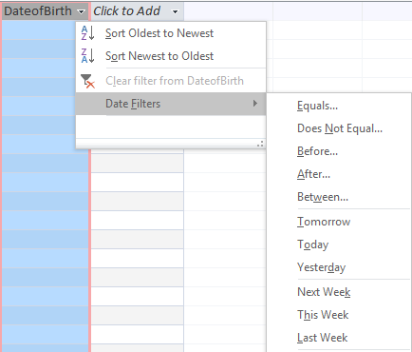
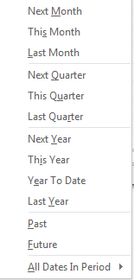
Datasheet Filters (cont.)
Date columns have huge selection of filter options

Slide 7
Filters vs. Queries
Filters are useful for 'one-off' searches
However, Filter settings cannot be saved.
  The next time you want to repeat the search, you need to re-create all of the filter settings again.
Queries by comparison are most useful when a search will be repeated.
  Filters can be saved as a 'Query'
  A query can be re-run repeated may times
  A query can behave just like a table.
  A new query can use an existing query as its source (instead of a table)

Slide 8
Queries
An Access query is literally a question that you ask about your data
  e.g. What is the name and rating code of all movies that were released in the year 2015.
To Build a query think about:
  Which table(s) store this data
  Which fields do you want displayed
  What criteria does a record have to match
  What sequence do you want to matching data to appear in

Slide 9
Queries (cont.)
Q: What is the title and rating code of all movies that were released in the year 2015.
  Which table are necessary?
    Movie table
  Which fields do you want displayed
    Title, RatingCode
  What criteria does a row have to match
    Relyear must be equal to 2015
  What sequence do you want to matching data to appear in
    Alphabetical by title

Slide 10
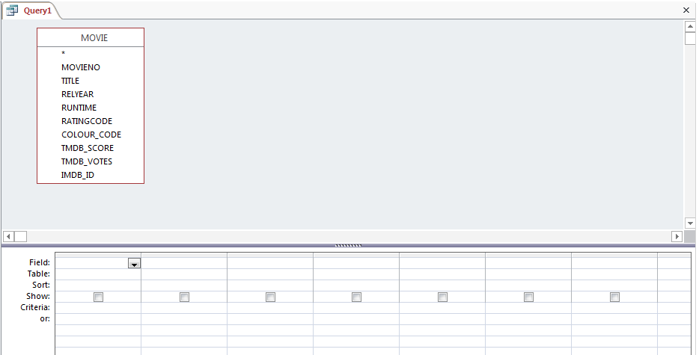
Query Design Grid
Q: What is the title and rating code of all movies that were released in the year 2015?
Query Design Grid

Slide 11
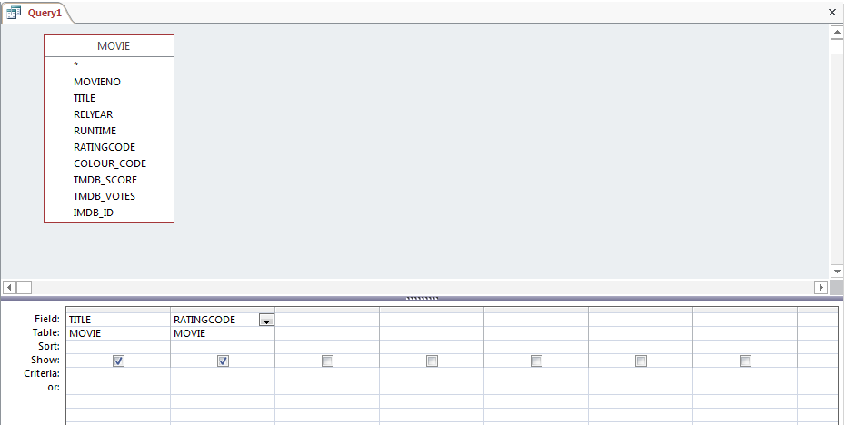
Query Design Grid (cont.)
Q: What is the title and rating code of all movies that were released in the year 2015?
Add each field / column to the Design Grid
(via drag n drop or double click)
The Show check box is selected

Slide 12
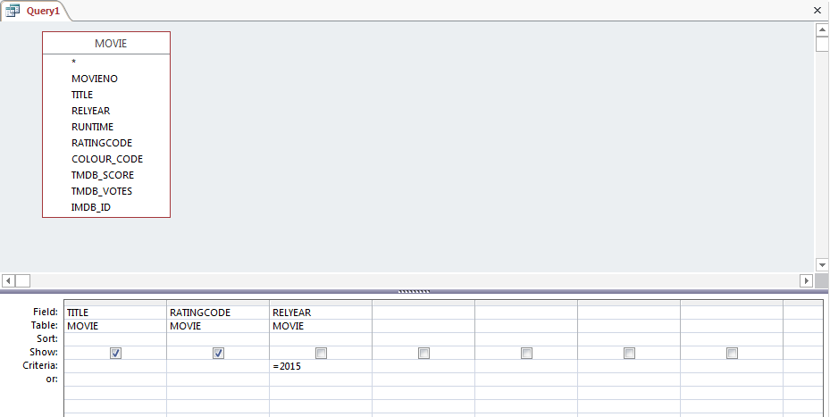
Query Design Grid (cont.)
Q: What is the title and rating code of all movies that were released in the year 2015?
Add the Relyear field / column to the Design Grid
  Do not select Show
  Specify the criteria that reach row must satisfy

Slide 13
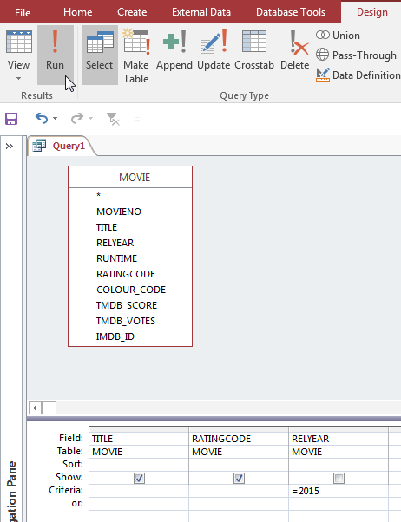
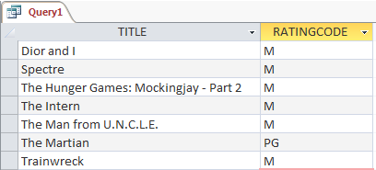
Run the Query
Click the Run ! to execute the query
A Datasheet view appears with the matching rows

Slide 14
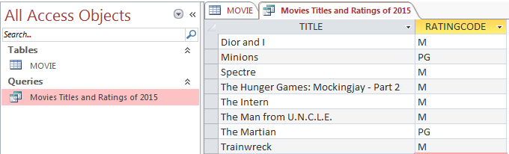
Saving Queries
A Query can be saved and executed again at a later time.
The Query is saved within the database.
This database now contains
  A Table named Movie
  A Query named Movie Title and Ratings of 2015
To run the query again, simply double click on the Query named Movies Titles and Ratings of 2015.

Slide 15
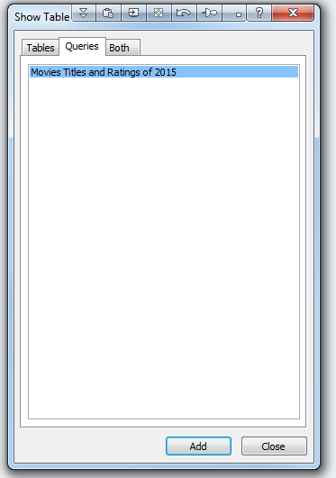
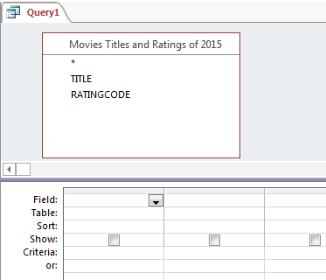
Reusing Queries
Queries are often treated in the same way as Tables within Access
Let us suppose we want to change the criteria
Now, we only want to display PG movies from the year 2015
We could edit and modify the previous query.
Instead… we can create a new query
Create a New Query via Create / Query Design menu option.
Don't base the data on a table but instead choose ‘Movie Titles and Ratings of 2015’ from the Queries tab.
The only columns that are available for this query
are Title and RatingCode

Slide 16
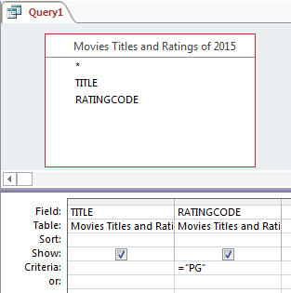
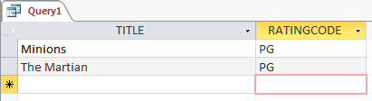
Reusing Queries (cont.)
Add the Title and RatingCode fields / columns to the Design Grid.
Add a criteria to RatingCode so that only PG movies are displayed.
You could save this as a new query.

Slide 17
References on Queries
There are many resources available describing how to create Access Queries
The Access Bible 2016 available on-line via Swinburne Library.
Also:
  https://support.office.com/en-us/article/Examples-of-query-criteria-3197228c-8684-4552-ac03-aba746fb29d8?ui=en-US&rs=en-US&ad=US&fromAR=1
  https://support.office.com/en-us/article/Use-the-OR-criteria-to-query-on-alternate-or-multiple-conditions-d04b3e63-b477-430e-8fdc-7e37189ede88
  https://support.office.com/en-us/article/Examples-of-Access-query-criteria-0c7e9394-c485-454f-bc00-3bd3ec617805
  http://www.gcflearnfree.org/access2013/query-criteria-quick-reference-guide/1/
  http://www.fontstuff.com/access/acctut06.htm

Slide 18
Multiple Criteria, Keywords, and Wildcards
AND | OR | LIKE | Field Names

Slide 19
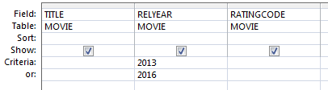
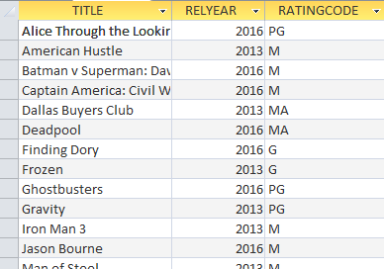
Multiple criteria in a field
When a field has multiple values on multiple rows in the Criteria section, it means that a movie record only needs to satisfy ONE of the criteria
Meaning: Evaluate each record. Select the record when
  the relyear is equal to 2013
  OR
  the relyear is equal to 2016
Either criteria must be met by a record.

Slide 20
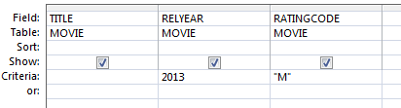
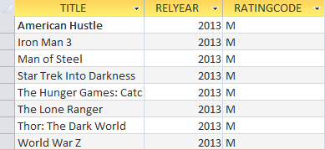
Multiple criteria in multiple fields
When multiple fields have values the
Criteria section, it means that a movie record must satisfy ALL of the criteria
Meaning: Evaluate each record. Select the record when
  the relyear is equal to 2013
    AND
  the ratingcode is equal to "M"
Both criteria must be met by a record.
When reading the Criteria across the query it means AND

Slide 21
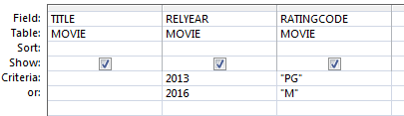
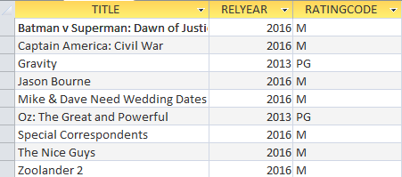
Multiple criteria in multiple fields (cont.)
When multiple criteria rows have multiple
values in the Criteria section, it is tricky.
Evaluate each record against each
Criteria row separately.
If a record meets all the Criteria of a
Criteria Row, then that record is selected.
Meaning Evaluate each record. Select the record when
  All of Criteria A is satisfied
  OR
  All of Criteria B is satisfied
Either criteria A or criteria B must be met by a record.
A
B

Slide 22
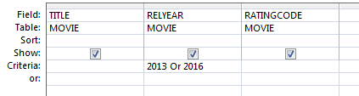
An alternative way to perform OR
You can use the OR keyword instead of using multiple rows in the Criteria area
Meaning Evaluate each record. Select the record when
  the relyear is equal to 2013
  OR
  the relyear is equal to 2016

Slide 23
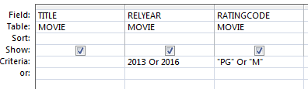
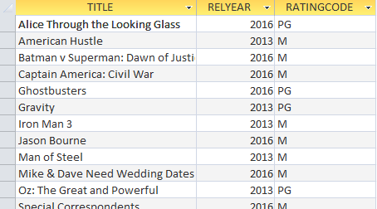
An alternative way to perform OR (cont.)
You can use the OR keyword instead of using multiple rows in the Criteria area
Meaning. Evaluate each record. Select the record when
  (the relyear is equal to 2013
  OR the relyear is equal to 2016)
    AND
  (the ratingcode is equal to "PG“ OR the ratingcode is equal to "M")
This means you can have
2013 And PG , 2013 And M
Or 2016 And PG, 2016 and M

Slide 24
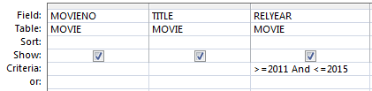
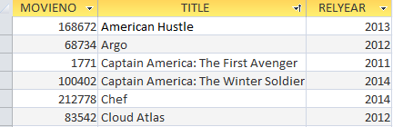
An alternative way to perform AND
You can use the AND keyword in the Criteria area.
It is most useful when defining a numeric range.
Meaning Evaluate each record. Select the record when the relyear is between 2011 and 2015

Slide 25
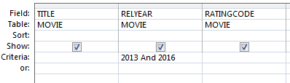

Be carful with AND
Be careful when using AND
Try to understand what you are searching for.
Meaning:
Evaluate each record. Select the record when
  the relyear is equal to 2013
  AND
  the relyear is equal to 2016
This is impossible!!!!!
Empty.
No rows match this criteria

Slide 26
Text criteria
When specifying text values in the Criteria section, the text must be surrounded by double quotes
Access is not case sensitive: ”The” is the same as "THE" and "the"
The opposite is true in other databases
In Oracle, "THE" is different to "The" and "the"

Slide 27
Text Wildcards
You can use Wildcards in access
Notice the space after the
If no space then you will get an outcome like “Thelma and Louise”
when you actually want only Titles that start with THE
These must be used with the ‘Like’ keyword
The Like condition allows you to use wildcards to perform pattern matching
The patterns that you can use are:
Wildcard | Description | Example | Explanation
* | Allows a match of any string of any length | Like "the *" | Title must begin with "the"
 |  | Like "*day*" | Title must contain day
? | Allows a match on a single character | Like "the ????" | Title must begin with "the" and be followed by exactly 4 characters

Slide 28
Field Names
When creating field names
  Avoid using spaces
  Use letters A-Z, a-z, and numbers 0-9
In queries you will often see examples of field names surrounded by square brackets
  e.g. [movieno] [title] [relyear]
This was introduced because Access allows you create field names that contain spaces! (Please avoid doing this! Leads to headaches).
Using [ ] is the only way to tell Access the start and end charters of a field name

Slide 29
Tasks based on Week 1 Lecture
There are tutorial questions and submission tasks associated with this lecture.
The tutorial questions…
  Should be reviewed by students after this lecture
  They will be discussed in the tutorial.
  Tutorial usually discus topics from the previous week's lecture
  Topics discussed in the above sessions may appear in tasks and in tests
The submission tasks…
  Can be completed in your own time( remember to check deadlines)
  You will need MS Access for the first few weeks of the semester
  The completed tasks must be submitted via Canvas

Slide 30
End.
Thanks for viewing the recordings. Good luck this Semester ☺.

